Slide 1

Final Project: STUDY of COMMUNITIES in GITHUB with a membership network
LINMA2472: ALGORITHMS IN DATA SCIENCE
Author: Manuelle Ndamtang

Slide 2
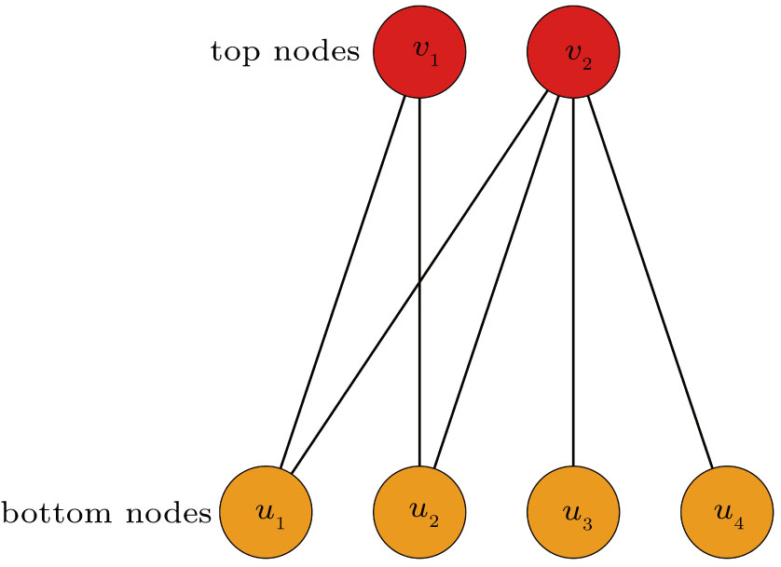
Network features
Bipartite graph
Number of nodes: 177 386
Number of edges: 440 237
The number of connected components: 15 067
Number of users: 56 519
Number of projects: 120 867

Slide 3
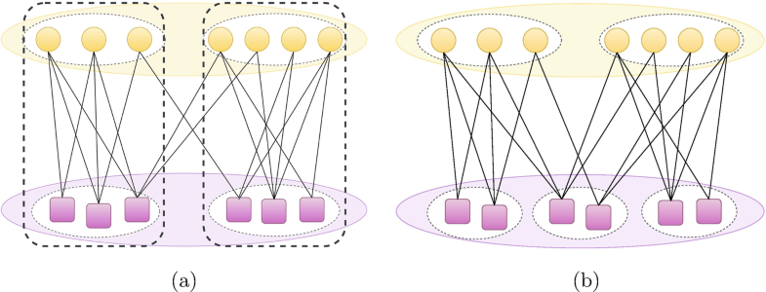
TWO WAYS to DEFINE communities
One-to-one correspondence communities
Many-to-many correspondence communities
Notes:
1, To detect the groups of nodes densely connected. This is the same as the definition of community in unipartite networks.
2, the groups of nodes that are of the same type and have similar link patterns

Slide 4


Community detection in the graph with the bipartite louvain algorithm
Library from the paper: “Improving Performances of Top-N Recommendations with Co-clustering Method”
Easy to use
Use projection
Instability
The number of communities detected: ~17 690
Notes:
1,

Slide 5
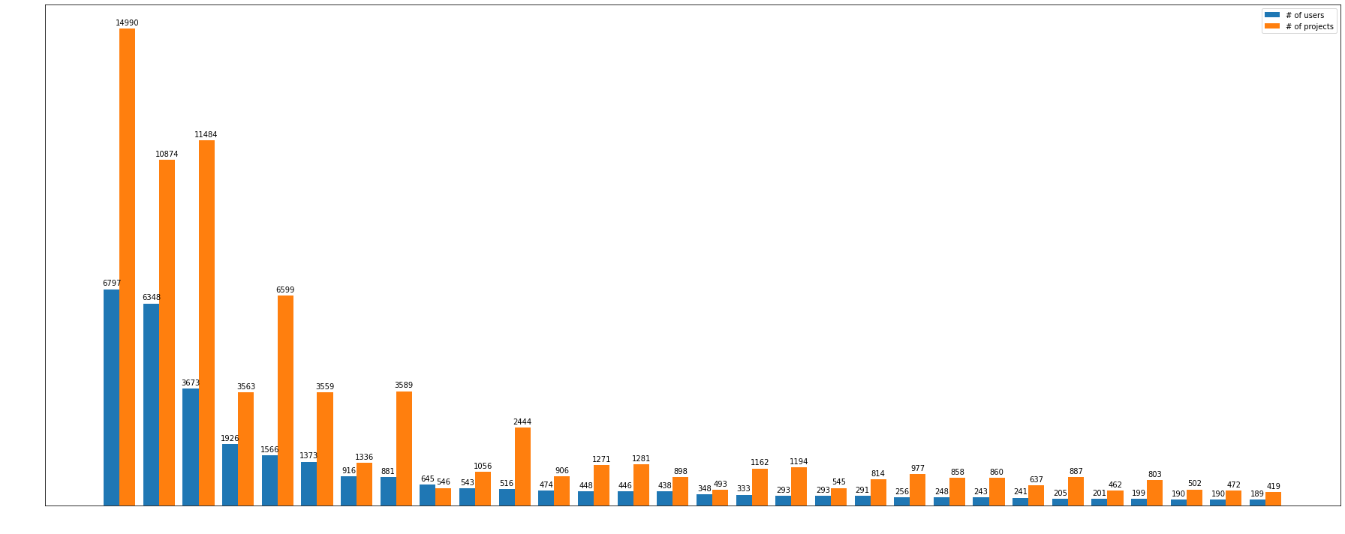
Community detection in the graph with the bipartite louvain algorithm

Slide 6
COMMUNITY DETECTION using BIMLPA
From paper: “BIMLPA: Community Detection in Bipartite Networks by Multi-Label Propagation”
More precise
Stable algorithm
Need of many iterations
Hard to apply on large scale graph
After 100 iterations (max), number of communities: (28 558, 27 264)
Notes:
Based on the idea of multi-labels, they design a label propagation procedure that is specific for bipartite networks

Slide 7
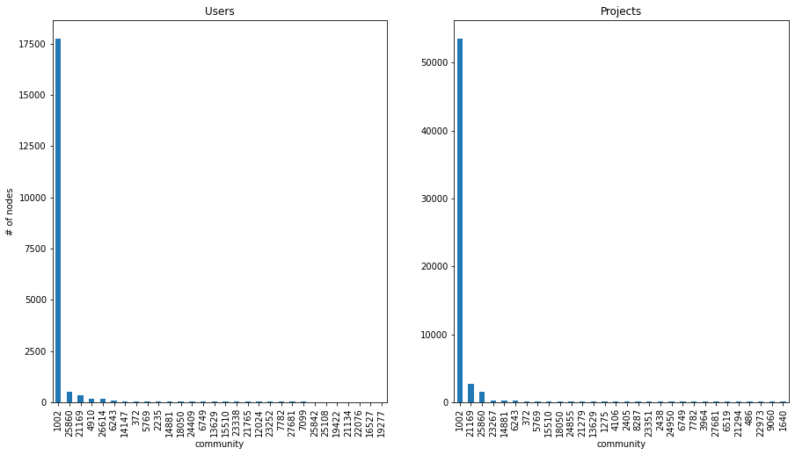
COMMUNITY DETECTION using BIMLPA
Notes:
To detect these community: I use 100iterations

Slide 8
Community Prediction: Apply machine learning to a subgraph
Build model to predict community for a node
Community based on bipartite Louvain algorithm
Use graph embedding
Create a predictive model

